Slide 1

SQL Server Admin Best Practices with DMV's
William Assaf, Sparkhound

Slide 2
SQL Server Admin Best Practices with DMV's
An incomplete tour of SQL Server DMV’s, covering the most important topics and getting you started on getting the most you can out of these crucial performance indicators.

Slide 3
Audience
Everyone can benefit from knowledge of these helpful tools, from developers to report writers to DBA’s of all levels of experience.
Toolbox available:
github.com/williamadba/sql-server-toolbox

Slide 4
Purpose of this Presentation
There are far too many DMVs to be covered in the scope of this presentation, here are the most useful and popular.
Getting anything out of DMVs will require you to get your hands dirty with them, yourself.
Short, quick-hitting labs throughout.
We won’t get to all the labs, but you can download them!
Share practical, everyday uses and scripts.

Slide 5
STOP ME
If you have a question
If you have used the DMV in an interesting, practical way
If you’d like to stare at the TSQL code a little bit longer
Don’t worry – slides and samples will be posted on my blog at SQLTact.com

Slide 6
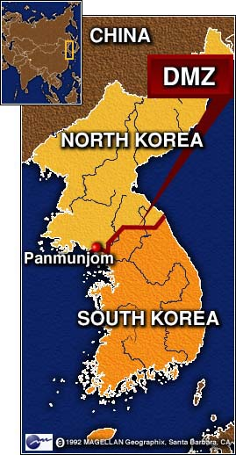

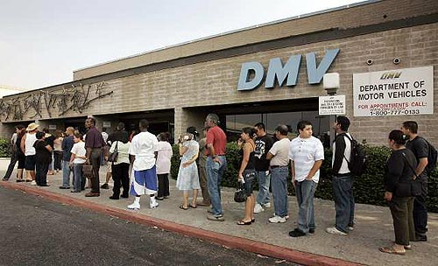




What Is a DMV?
Dynamic Management Views are in place to provide system transparency.
The DMV’s we are talking about today are the foundation of countless third party SQL monitoring applications.

Slide 7
What Is a DMV?
SQL 2005 and above only.
Individual databases must also be in 90 compatibility mode or higher
If you’re still administering SQL 2000 servers, GET OUT.

Slide 8
What Is a DMV?
Some DMV’s are actually DMF’s, table-valued Functions, with parameters.
They all fall into a category of DMO’s.
For these purposes, we will call them all DMV’s, because we can make more jokes about DMV’s.
Notes:
They could also be called DMO’s, Dynamic Management Objects, but that acronym is already taken by Distributed Management Objects.

Slide 9
Permissions
Most DMV’s require only:
VIEW SERVER STATE
or
VIEW DATABASE STATE
grant view server state to [sparkhound\william.assaf] grant view database state to [sparkhound\william.assaf]
These are read-only permissions that may be appropriate for developers in prod.

Slide 10
Ready?

Slide 11
sys.dm_db_index_physical_stats
Determine index fragmentation to do SQL-level defrag.
The avg_fragmentation_in_pct column shows logical fragmentation for indexes and extent fragmentation for heaps.
Replaces the functionality of DBCC SHOWCONTIG to an extent.
(that’s a pun, get it?)

Slide 12
sys.dm_db_index_physical_stats
Compared to DBCC SHOWCONTIG, which still works, sys.dm_db_index_physical_stats is more accurate. The fragmentation will appear higher.
For example, in SQL Server 2000, a table is not considered fragmented if it has page 1 and page 3 in the same extent but not page 2. However, to access these two pages would require two physical I/O operations, so this is counted as fragmentation in SQL Server 2005 and above.

Slide 13
sys.dm_db_index_physical_stats
Will still show tables without clustered indexes as Index_id = 0, HEAP. However, this isn’t really useful.
Index_ID = 1 is the clustered index.

Slide 14
sys.dm_db_index_physical_stats
When to use?
Use while your application is in production to recognize tables that are experiencing more fragmentation over time.
Schedule table or index-level rebuilds appropriately.

Slide 15
While we’re on the topic…
ALTER INDEX … REORGANIZE replaces
DBCC INDEXDEFRAG
ALTER INDEX … REBUILD replaces DBCC DBREINDEX, also updates the statistics
ALTER INDEX … REBUILD ALL rebuilds all indexes on a table

Slide 16
sys.dm_db_index_physical_stats
Typical usage for:
one table in the current database,
all indexes and all partitions,
default scan depth.
Select * from
sys.dm_db_index_physical_stats (
db_id(),
OBJECT_ID(‘dbo.person'), --NULL
NULL,
NULL,
NULL --mode)

Slide 17
sys.dm_db_index_physical_stats
MODE parameter options for Scan Depth:
LIMITED
Fastest, default, because it only scans parent-level pages, not leaf-level.
Only returns basic metrics, leaves the rest NULL.
Only mode that can be used on heaps.
SAMPLED
Not as fast, samples 1% of leaf pages.
DETAILED
Much more involved. Samples all data pages.
Will hammer your Disk IO. (Don’t run on live production db!)
Only way to get some of the columns to populate.

Slide 18
sys.dm_db_index_physical_stats
Lab
lab - fragmented table.sql
defrag.sql

Slide 19
Aside, on Fragmentation
Why did the Microsoft Windows 7 RC download page break?
Notes:
See this still happening in Microsoft products, including CRM.

Slide 20
sys.dm_db_index_physical_stats
Is it time to Compress?
If you haven’t begun using DATA_COMPRESSION in your ENTERPRISE edition SQL Server databases in SQL 2008 or higher, now is a good time.
In SQL 2016 SP1 – this feature was moved into STANDARD edition!
The Clustered Index and Nonclustered Indexes can be compressed independently from each other.
ALTER INDEX ALL ON schema.table REBUILD WITH (DATA_COMPRESSION = PAGE)

Slide 21
sys.dm_os_wait_stats
Aggregated wait times – records when something has to wait and retains it.
Records count of tasks experiencing the wait type, sum of time and max time waiting.
There are 924 (more or less documented)
wait types in SQL 2017.
Notes:
Best to exclude types that match ‘%SLEEP%’ because those are related to db system startup waits or background task waits and shouldn’t be considered part of user performance.

Slide 22
sys.dm_os_wait_stats
Wait Stats can be powerful diagnostic tools.
Many performance suits do little more than incorporate Wait Stats data for charts in their dashboards, but they also are great sponsors of user groups and SQLSaturday events!

Slide 23
sys.dm_os_wait_stats
ONDEMAND_TASK_QUEUE – high wait times of this type indicate lots of SQL Server idle time.
These wait times also indicate idling and are not problematic:
BROKER_TRANSMITTER BROKER_RECEIVE_WAITFOR DBMIRROR_WORKER_QUEUE KSOURCE_WAKEUP CLR_AUTO_EVENT LOGMGR_QUEUE REQUEST_FOR_DEADLOCK_SEARCH QDS_SHUTDOWN_QUEUE
and many many more..

Slide 24
sys.dm_os_wait_stats
LCK_M_* - Lock waits
Reference sys.dm_tran_locks if this number is consistently at the top of the server’s waits.
This is a sign of transaction contention.
Could be that poor queries/indexing are creating too many scans, where a nonclustered index seek could relieve this pressure.
Synchronous AvailabilityGroup replicas could increase this wait type.
Lots of LCK_M_ waits?
Consider RCSI – Read Committed Snapshot Isolation

Slide 25
sys.dm_os_wait_stats
CXPACKET – clear indication of excessive execution plan parallelism and CPU is struggling to keep up.
Look into MAXDOP settings, it may be appropriate to reduce large parallel queries from impacting performance
Enforcing MAXDOP is one of the better implementations of the Resource Governor (Enterprise-only)

Slide 26
sys.dm_os_wait_stats
SOS_SCHEDULER_YIELD – clear indication of CPU pressure when this is the highest wait
Too many runnable tasks for available threads
A SQL stopped operation and “yielded” to another CPU task
Increasing CPU is the simplest but most difficult and expensive solution
Reducing CPU-intense queries

Slide 27
sys.dm_os_wait_stats
RESOURCE_SEMAPHORE – request is waiting on memory to be gathered before starting
Indication of memory pressure caused by:
Insufficient system memory (unlikely)
Poor query design, poor indexing, inefficient execution plan (likely)

Slide 28
sys.dm_os_wait_stats
PAGELATCH_xx - Nothing to do with Physical IO. Multiple threads are attempting to access a page in memory. Contention over a page in memory.
Could be tempdb temp tables are being overused.
Could be an INSERT statement hotspot on a table.
PAGEIOLATCH_xx – This is Physical IO, reading data from disk into memory. Hard disks/SAN are struggling to keep up.
Often this is because of inefficient application code
Or, executives/analysts/goons are running MS Access or Excel and pulling down entire tables

Slide 29
sys.dm_os_wait_stats
When to use?
Use on healthy or troubled systems, look for trending from a baseline.
Determine which waits are impacting performance server-wide. It is one of the best DMV’s for server-wide performance.

Slide 30


sys.dm_os_wait_stats
Great for pointing the finger at
Network Admins!
(just kidding)

Slide 31

sys.dm_os_wait_stats
Again, sys.dm_os_wait_stats is aggregated
Doesn’t include live data, for that you’ll need the next DMV…

Slide 32
sys.dm_os_waiting_tasks
sys.dm_os_waiting_tasks shows all tasks currently waiting, not aggregated over time.
Use to troubleshoot sudden performance problems, and trace it down to the query.
Use to identify all wait types (including blocking and locking) down to the statement level

Slide 33
sys.dm_os_waiting_tasks
Join it to sys.dm_exec_requests (we’ll talk about that one later) on the waiting_task_address, then to dm_exec_sql_text on the sql_handle to get the query text. Use offsets to determine the statement inside a batch that is waiting.
Sessions > 50 are user sessions, so include that in your WHERE clause when accessing this DMV.

Slide 34
sys.dm_exec_session_wait_stats
New for SQL 2016!
A hybrid of the previous two, sys.dm_exec_session_wait_stats provides waits for the current session – so that you can troubleshoot what a specific query or application is incurring.
Instead of server-wide waits or current waits, we can drill into specific query waits aggregated with the session connection.
The syntax is the same as the aggregated sys.dm_os_wait_stats, but includes an extra column for session_id.

Slide 35
Wait Type DMV’s
Lab
dm_os_wait_stats.sql - Aggregate Wait Stats Data
dm_os_waiting_tasks.sql – Live Wait Stats Data

Slide 36
sys.dm_exec_query_stats
Stores performance information about the cached query plans in memory, but rows do not persist after a plan is removed from the cache.
Provides a sql_handle and offsets (integers) to identify the statement within a batch or stored procedure using sys.dm_exec_sql_text.
One row per query statement within cached plan.

Slide 37
sys.dm_exec_query_stats
Used by MS PSS for in-depth performance tuning
Total_worker_time is CPU time
Records total writes, total reads and can be used in summary to measure database activity.

Slide 38
sys.dm_exec_query_stats
Lab
Worst queries.sql

Slide 39
sys.dm_exec_sessions
Queryable session info
In SQL 2012, now includes the column open_transaction_count, removing the last of the reasons you ever needed to use:
select *
from sys.sysprocesses

Slide 40
sys.dm_exec_requests
Shows current activity, much like SP_WHO2
Shows only active requests (ignores SLEEPING)
provides a sql_handle and offsets (integers) to identify the statement within a batch or stored procedure using sys.dm_exec_sql_text
Why are offset values off by a factor of 2?
SQL Stores sql command text internally in Unicode.

Slide 41
sys.dm_exec_requests
Use the percent_complete column to check the exact progress of BACKUP and RESTORE operations.
Combined with the start_time value, can estimate a completion datetime as well.
Example:
Backup restore progress.sql

Slide 42
sys.dm_exec_requests
In this manner, sys.dm_exec_requests can replace DBCC INPUTBUFFER for live requests
These return different data inside a live trigger execution.
But, sys.dm_exec_requests can return more accurate text within a batch using the offsets.

Slide 43
sys.dm_exec_input_buffer
DBCC INPUTBUFFER still not deprecated by SQL2017
Has been effectively replaced by a new DMF introduced in SQL 2014 SP2
sys.dm_exec_input_buffer (session_id, request_id)
This can display the last command issued to a session, even if there is no live request.

Slide 44
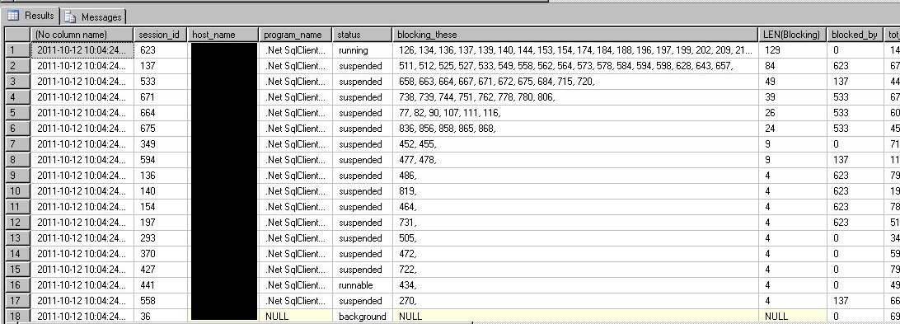
Sessions + Requests
Put them together for a super server status query:
sessions and requests.sql

Slide 45

Indexes

Slide 46
Missing Indexes Views
My favorite feature of introduced by SQL 2005.
Four DMV’s record whenever a queryplan recognized the need for an index that could have improved performance.
SQL records that recognized need, along with estimated statistics on cost and improvement of the new index.

Slide 47
Missing Indexes Views
sys.dm_db_missing_index_groups
sys.dm_db_missing_index_group_stats
sys.dm_db_missing_index_details
Passive. Doesn’t need to be turned on.
Cleared out when the server is rebooted, also cleared out for a table when you alter the table or indexes on that table.
Only recommends nonclustered indexes.
Won’t recommend a clustered index on a heap, you have to fix that problem!
Won’t recommend columnstore, xml, spatial index types.
Won’t recommend compression setting.

Slide 48
Missing Indexes Views
Must be used with sobriety. Don’t create every suggested missing index or your update/insert/deletes will suffer…
Writes can sometimes still benefit from nonclustered indexes by making more efficient queries from the source query (seeks instead of scans).
One index should be created to satisfy many suggestions.
Suggestions may only differ by column order, the columns in the key vs. INCLUDE’d, or by a small number of columns.
Combine suggestions together
Combine with existing indexes as well

Slide 49
Missing Indexes Views
An existing index may have all the columns needed, but some are in the INCLUDE, not the key of the index.
or,
An existing index may need only one additional column in the key or INCLUDE.
If so, CREATE INDEX … WITH (DROP_EXISTING = TRUE…) to replace the existing index easily.
Always consider using ONLINE = ON.

Slide 50
Missing Indexes Views
When to use?
After you have actual usage running against production.
Don’t use during development, too likely to be misleading.
Do use during user acceptance testing to simulate actual usage.
Do use on your production environment after a stable period of active and typical activity.
Try to capture a business cycle (weekly payroll, month-end reporting, quarterly or annual, etc.)

Slide 51
Missing Indexes Views
This is a very fast way to enter an environment, and take a peek at the indexing situation.
Are there lots of missing indexes screaming to be created?
Are there indexes only in certain areas of the application?
Were indexes carefully created at the start of the application, but not recently?

Slide 52
Missing Indexes Views
Lab
lab - missing index setup demo.sql
missing indexes.sql

Slide 53
Final Note on Missing Indexes Views
Since SQL 2008 – Missing index views have been integrated into the show query plan screens in SSMS.
But don’t use this to create new indexes.
Take a look at the whole picture, including all suggested indexes and all existing indexes, before creating any indexes.
Treat this as an alert that you may need to pay some attention to the missing indexes DMVs.

Slide 54
sys.dm_db_index_usage_stats
Tracks access operations on all indexes and HEAPs, cumulatively.
Data resets with the server or with the index object.
Retains data through maintenance operations.
Joins easily to sys.indexes on object_id.
Exclude built-in indexes: OBJECTPROPERTY([object_id], 'IsMsShipped') = 0

Slide 55
sys.dm_db_index_usage_stats
How to use?
Low or zero values in user_lookups, user_seeks, user_scans (reads) = This index isn’t being used.
User_updates (writes) greater than the sum of reads = This index might hurt more than it helps.
This criteria should be different based on intended table usage.

Slide 56
sys.dm_db_index_usage_stats
When to use?
Similar to the missing index DMV’s.
Use this after a stable period of actual production use.
Try to capture a business cycle (weekly payroll, month-end reporting, quarterly or annual, etc.)

Slide 57
sys.dm_db_index_usage_stats
Lab
index_usage_stats.sql

Slide 58
sys.dm_os_performance_counters
Access to Perfmon stats with T-SQL (not WSQL!)
Replaces the deprecated sys.sysperfinfo
Includes hundreds of “SQLServer:” related performance counters, including all instances.
Slightly more involved to read than the values out of perfmon
For example, need to actually do some division between two rows to get the Buffer Cache Hit Ratio – a useful memory usage counter.

Slide 59
sys.dm_os_performance_counters
Lab
dm_os_performance_counters.sql
page life expectancy.sql

Slide 60
sys.dm_os_sys_memory
Includes total and available physical memory and cache levels.
Built in flags for Low/High memory availability from Windows
Application can use to automatically scale itself up/down based on available server memory.
Same technology is used for Windows memory pressure notifications in Hyper-V Dynamic Memory.

Slide 61


Were you aware?
Speaking of memory

Slide 62
sys.dm_server_services
SQL Server instance service information, including the last time the service was started, service file location, clustering information and service account name.
SELECT servicename -- Ex: SQL Server (SQL2K8R2)
, startup_type_desc -- Manual, Automatic
, status_desc -- Running, Stopped, etc.
, process_id
, last_startup_time -- datetime
, service_account
, filename
, is_clustered -- Y/N
, cluster_nodename
FROM sys.dm_server_services

Slide 63
sys.dm_server_registry
Returns potentially 100s of rows for all SQL-related registry keys and values in these locations:
HKLM\SYSTEM\CurrentControlSet\Services\
HKLM\Software\Microsoft\Microsoft SQL Server\instance\MSSQLServer\ (per instance)
HKLM\Software\Microsoft\Microsoft SQL Server\instance\SQLServerAgent (per instance)
SELECT
registry_key
, value_name
, value_data
FROM sys.dm_server_registry;

Slide 64
sys.dm_server_registry
SELECT
registry_key, value_name, value_data
FROM sys.dm_server_registry
WHERE registry_key like 'HKLM\Software\Microsoft\Microsoft SQL Server\%\MSSQLServer\Parameters'
value_name | value_data
SQLArg0 | -dE:\Program Files\Microsoft SQL Server\MSSQL14.SQL2K17\MSSQL\DATA\master.mdf
SQLArg1 | -eE:\Program Files\Microsoft SQL Server\MSSQL14.SQL2K17\MSSQL\Log\ERRORLOG
SQLArg2 | -lE:\Program Files\Microsoft SQL Server\MSSQL14.SQL2K17\MSSQL\DATA\mastlog.ldf

Slide 65

sys.dm_os_volume_stats
Bypass WMI calls – get physical drive size/available space from within SQL
Join to sys.master_files to info on data and log files
Unfortunately, for space on ALL disks, still have to use ye olde exec xp_fixeddrives

Slide 66
sys.dm_os_volume_stats
Lab
Volume stats.sql

Slide 67
Sys.dm_io_virtual_file_stats
Return information about file usage
Can be used to gauge database file activity based on IO traffic, including:
reads and writes in counts and amount of data,
plus IO_Stall data for time spent retrieving data from disk.

Slide 68
Sys.dm_io_virtual_file_stats
Includes an ascending counter in milliseconds that can be used to measure the data over intervals.
Lab:
record_dm_io_virtual_file_stats.sql

Slide 69
Sys.dm_OS_RING_BUFFERS
Access to ring buffer endpoints of XEvents sessions
The System Health session already gathers a lot of data, including a history of CPU, Memory utilization
and the only way to find Deadlocks in the recent past without having set up anything to capture them
Lab:
sys_dm_os_ring_buffers.sql
deadlocks in xevents.sql

Slide 70
sys.dm_hadr_cluster
Returns information about AlwaysOn Availability Groups in SQL 2012
Doesn’t matter if primary or secondary, but many DMV’s require you to run on the current primary replica for an AG to see complete information.
Also use sys.dm_hadr_cluster_members to see members.

Slide 71
sys.dm_hadr_cluster
Combine with
Sys.dm_hadr_database_replica_states,
And sys.dm_os_performance_counters
For a solid performance monitor for Availability Groups,
Including all current configuration, and endpoints
Including your current RPO/RTO (especially useful for asynchronous replicas) and last commits on each secondary replica

Slide 72
sys.dm_hadr_cluster
Lab
Availability Groups/AG_Monitor.sql

Slide 73
Helpful links, sources for this presentation, and continued reading:
http://www.sqlskills.com/BLOGS/PAUL/post/Why-did-the-Windows-7-RC-failure-happen.aspx
http://technet.microsoft.com/en-us/library/cc966413.aspx
http://msdn.microsoft.com/en-us/library/ms188917.aspx
http://www.codeproject.com/KB/database/Dynamic_Management_Views.aspx
http://glennberrysqlperformance.spaces.live.com/blog/cns!45041418ECCAA960!1446.entry
http://sharmilasanctuary.wordpress.com/about/database-performance-dmvs-for-ms-sql-2005/
http://sqlblog.com/blogs/kevin_kline/archive/2009/04/07/looking-for-good-dmv-database-admin-queries.aspx
http://blogs.msdn.com/jimmymay/archive/2008/10/30/drum-roll-please-the-debut-of-the-sql-dmv-all-stars-dream-team.aspx
http://blogs.msdn.com/psssql/archive/2007/02/21/sql-server-2005-performance-statistics-script.aspx
http://msdn.microsoft.com/en-us/magazine/cc135978.aspx
http://www.sqlservercentral.com/articles/DMV/64425/
http://www.sqlskills.com/BLOGS/PAUL/post/Inside-sysdm_db_index_physical_stats.aspx
http://www.sqlskills.com/BLOGS/PAUL/post/Indexes-From-Every-Angle-How-can-you-tell-if-an-index-is-being-used.aspx
http://kswain.blogspot.com/2008/04/sysdmosperformancecounters-dynamic.html
http://www.sqlpassion.at/archive/2014/11/24/deadlocks-caused-by-missing-indexes-in-sql-server
http://www.sql-server-performance.com/articles/per/bm_performance_dashboard_2005_p2.aspx
http://msdn.microsoft.com/en-us/library/aa366541%28VS.85%29.aspx
http://sqlblog.com/blogs/aaron_bertrand/archive/2011/04/25/more-changes-you-might-not-have-noticed-in-the-sql-server-2008-r2-sp1-ctp.aspx
http://www.sqlskills.com/BLOGS/PAUL/category/Spinlocks.aspx

Slide 74



HEALTH CHECK
REMEDIATION
MANAGED SQL
What’s covered in the Health Check?
Windows Server and VM Host/Guest configuration, Patching
Disaster Recovery, High Availability solutions
SQL Server Configuration, Database Configuration
Security, Permissions and Authentication assessment
Regular Maintenance, Alerts and Monitoring, Performance Monitoring
Special focus on any areas of client need
For example: performance, pre-audit, security

Slide 75
HEALTH CHECK
REMEDIATION
MANAGED SQL
Remediation
We document findings, issues, and recommendations.
Divide into actionable steps towards increased maturity.
Remediation will be thoroughly detailed, executed collaboratively.
Stabilize the SQL environment for maintenance/monitoring.
Onsite or Remote, scheduled around Maintenance Windows.

Slide 76
HEALTH CHECK
REMEDIATION
MANAGED SQL
Managed SQL
Proactive Health Checks, Reactive Alerting, Integrated Processes
Leverage Sparkhound’s internal expertise delivering Managed Services, also including Managed SharePoint, Infrastructure, Support Services.
Single Point of Contact - Service Desk 24x7x365, dedicated 1-800.
Remote Support - Engage Tier 1-3 support remotely as appropriate.
Ticketing – Use our enterprise ticketing system or integrate.
Health - Monthly Stable State Health Check to deliver regular reports.

Slide 77
SQL Consulting Services
Performance Tuning
SSIS/SSRS
Upgrades/Migrations/Data Conversions
High Availability/Disaster Recovery solutions
Pre-audit, encryption, database security
Maintenance/administration
Automation/PowerShell
Azure SQL (IaaS or PaaS) architecture
Training/Knowledge Transfer/Skillset updates

Slide 78
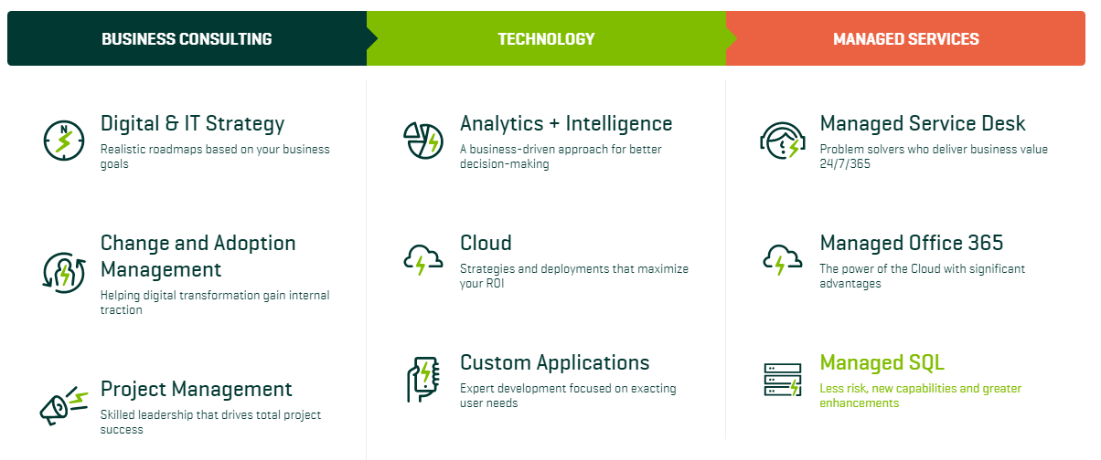
Sparkhound

Slide 79
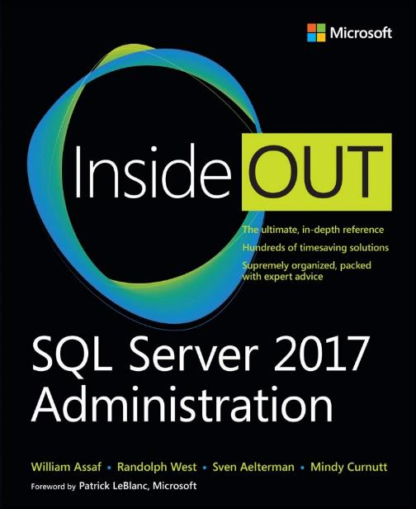
www.microsoftpressstore.com

Slide 80
Bio and contact
William D Assaf, MCSE
Baton Rouge SQL Server UG board and SQLSaturday chair
Principal Consultant, Manager – DBA Team at
Sparkhound Baton Rouge
William.Assaf@sparkhound.com
Twitter: @william_a_dba
This presentation, including all source code and this slide deck, has been posted at my blog:
SQLTact.com

